Slide 1
Light-weight Contexts: An OS Abstraction for Safety and Performance
Authors: James Litton, Anjo Vahldiek-Oberwagner , Eslam Elnikety , Deepak Garg , Bobby Bhattacharjee , and Peter Druschel
Presenter: Swathi Yadav

Slide 2
Contents
Introduction
LwC design
Common lwC usage patterns
Implementation
Evaluation
Conclusion

Slide 3
Introduction
A new OS abstraction Light-weight contexts (lwC).
It provides independent units of protection, privilege and execution state within a process.
A process may include several lwCs, each with possibly different views of memory, file descriptors, and access capabilities.

Slide 4
lwCs can be used to efficiently implement
Rollback: process can return to a prior recorded state
Isolated address spaces: lwCs within the process may have different views of memory, e.g., isolating sensitive data from network-facing components or isolating different user sessions.
Privilege separation: in-process reference monitors can arbitrate and control access

Slide 5
Background
Process have files, memory mapping, threads.
It also has system attributes like execution priorities.
If a user wants to create a new process, we use forking.
Forking is used to achieve distinct isolation, privilege separation and program state.
Forking imposes a scheduling and coordination overhead between processes.
In this paper the authors have offered an alternative approach by providing new abstraction called Light-weight contexts (lwC).

Slide 6
Light-weight contexts (lwC)
A process may contain multiple lwCs, each with their own virtual memory mappings, file descriptor bindings, and credentials.
lwCs are not schedulable entities: they are completely orthogonal to threads that may execute within a process.
lwCs enable a range of new in-process capabilities, including fast roll-back, protection rings, session isolation, and protected compartments.

Slide 7
Main Contribution.
Introduced lwCs, a first-class OS abstraction that extends the POSIX API, and present common coding patterns demonstrating its different uses.
Described an implementation of lwCs within FreeBSD, and show how lwCs can be used to implement efficient session isolation in production web servers, both process-oriented (Apache, via roll-back) and eventdriven (nginx, via memory isolation).
Evaluated lwCs using a range of micro-benchmarks and application scenarios.

Slide 8
lwC design
Each lwC has its own virtual address space, set of page mappings, file descriptor bindings, and credentials.
Threads and lwCs are independent.
Within a process, a thread executes within one lwC at a time and can switch between lwCs.
lwCs are named using file descriptors.

Slide 9
Creating lwCs
The lwCreate call creates a new (child) lwC in the current process.

Slide 10
Creating lwC
Unlike with fork, however, child and parent lwC share the same process id, and no new thread is created.
lwCreate returns the descriptor of the new child lwC new to the parent lwC with the caller descriptor set to -1.
When a thread switches to the new lwC (new) for the first time, the lwCreate call returns with the caller’s lwC descriptor in caller and the parent’s lwC descriptor in new, along with any arguments from the caller in args.
By default, the new lwC gets a private copy of the calling lwC’s state at the time of the call.

Slide 11
Creating lwC
To ensure that the child lwC reflects a consistent snapshot of the parent’s state, all threads that are active in the parent at the time of the lwCreate therefore should be in a consistent state.
A thread that does not exist in the parent lwC at the time of the lwCreate may not switch to the child in the future.

Slide 12
The lwCreate call takes several option flags.
LWC_SHAREDSIGNALS controls signal handling in the child lwC.
LWC_SYSTRAP indicates that any system calls for which the child does not hold the required OS capability should be redirected to its parent.

Slide 13
Switching between lwCs
lwSwitch operation switches the calling thread to the lwC with descriptor target, passing args as parameters.
When this lwC is later switched back into by the same thread, the call returns with the switching lwC available as caller and arguments passed in args.
lwSwitch is semantically equivalent to a coroutine yield.
In fact, as far as control transfer is concerned, lwCs can be viewed as isolated and privilege separated coroutines.

Slide 14
Static resource sharing
When a lwC is created using lwCreate, the child lwC receives a copy-on-write snapshot of all its parent’s resources by default.
The parent can modify this behavior using the resource-spec argument in the lwCreate operation.
The resource-spec is an array of C unions: each array element specifies either a range of file descriptors, virtual memory addresses, or credentials.

Slide 15
For each range, one of the following sharing options can be specified.
LWC_COW: the child receives a logical copy of the range of resource.
LWC_SHARED: the range of resources is shared among parent and child.
LWC_UNMAP: the range of resources is not mapped from the parent into the child.

Slide 16
Dynamic resource sharing
lwC may dynamically map (overlay) resources from another lwC into its address space using the lwOverlay operation.
The caller specifies which regions of a given resource type are to be overlayed, and whether the specified region should be copied or shared, in the resource-spec parameter.
The lwOverlay call will only succeed if the caller lwC holds access capabilities for the requested resources.

Slide 17
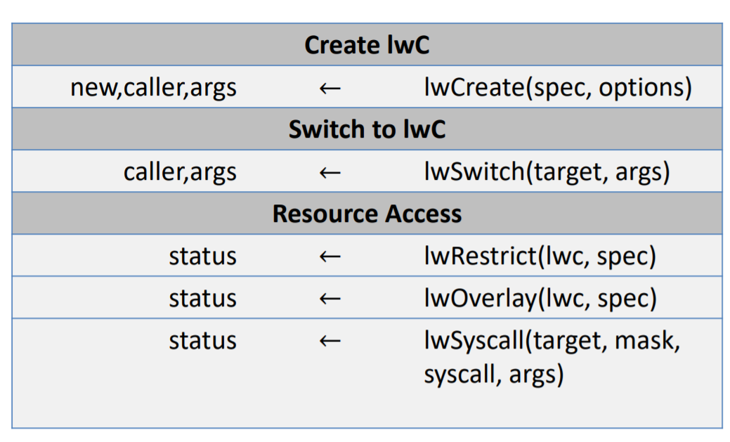
API Summary

Slide 18
Common Uses
Session Isolation
Sensitive data isolation
Snapshot and Rollback
Reference monitoring

Slide 19
Snapshot and rollback
A service process (such as a server worker process) initializes its state to the point where it is ready to serve requests (or sessions), snapshots this state, serves a request and rolls its state back to the snapshot before serving the next request.

Slide 20
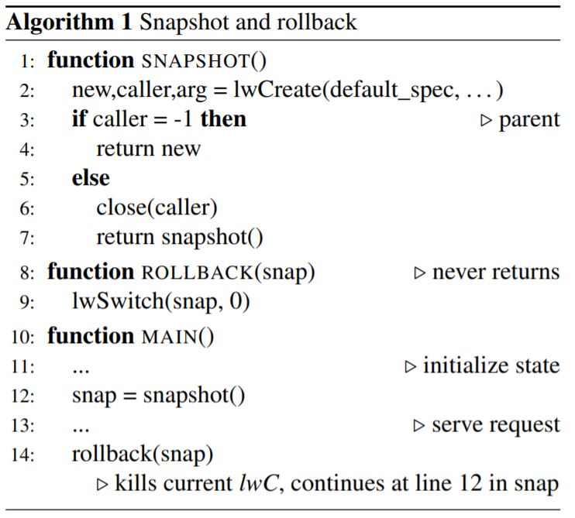

Slide 21
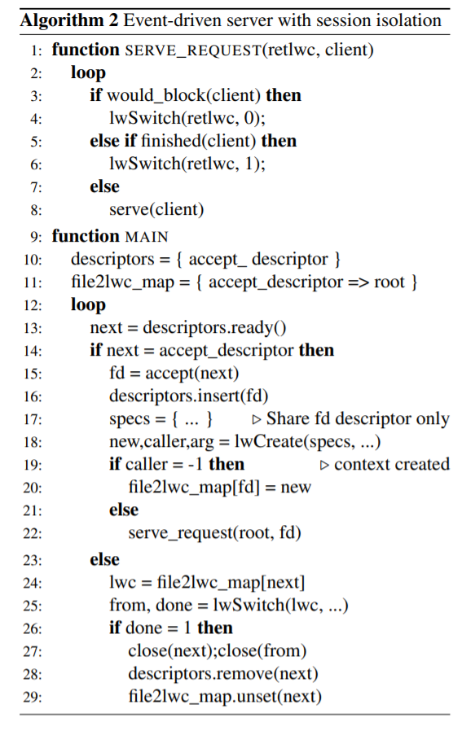
Event-driven server with session isolation
High throughput servers like nginx handle several sessions in single-threaded processes using event-driven multiplexing.
However, they provide no isolation among sessions within a process.
This shortcoming can be addressed using lwCs.
The program defines a set of network socket descriptors to poll, one for each client connection and sets a mapping of the listening socket descriptor to the current lwC.

Slide 22
Sensitive data isolation
A third common use pattern isolates sensitive data within a process by limiting access to a single lwC that exposes only a narrow interface.
As an illustration, Algorithm 3 shows how to isolate a private signature key that is available to a signing function, but kept hidden from the rest of the (large and networkfacing) program.

Slide 23
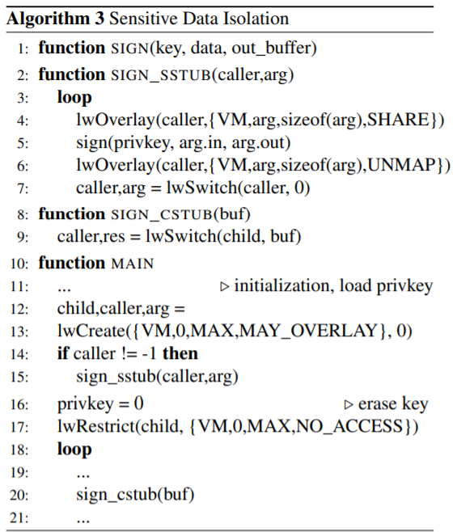
The main function initializes the program and loads the private signing key into the variable privkey.
Next, it calls lwCreate to create a second lwC with the same initial state.
The child lwC, which will become the isolated compartment with access to the privkey, is granted the privilege to overlay any part of the parent’s virtual memory.

Slide 24
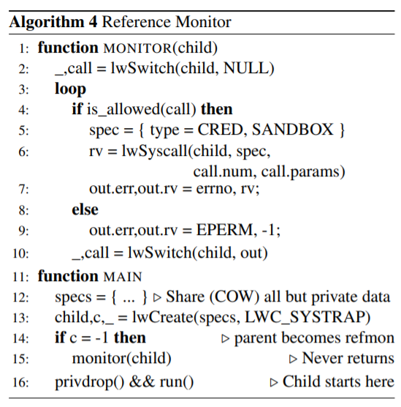
Protected reference monitor.

Slide 25
Ealuation
Microbenchmarks
lwCreate
lwSwitch
Reference monitoring (systrap)
Apache (v. 2.4.18)
Session isolation
Reference monitoring
Nginx (v. 1.9.15)
Session isolation
Reference monitoring
SSL private key isolation
PHP (v. 7.0.11)
Fast startup via snapshots

Slide 26
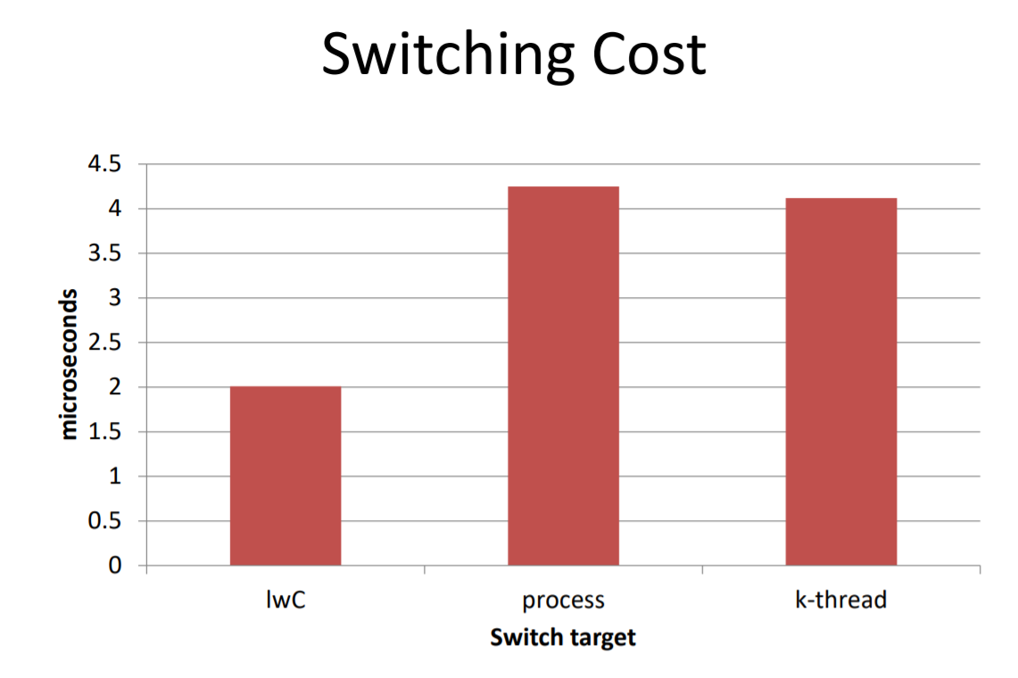

Slide 27
Evaluation – nginx
High performance web server.
Asynchronous & event-driven
No session isolation

Slide 28
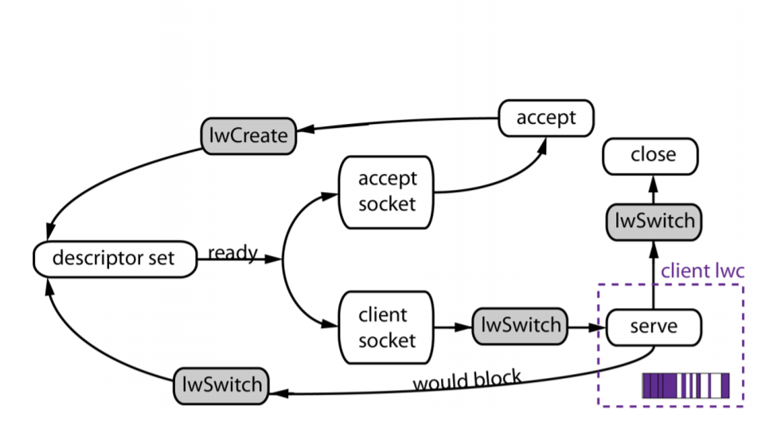
nginx execution

Slide 29
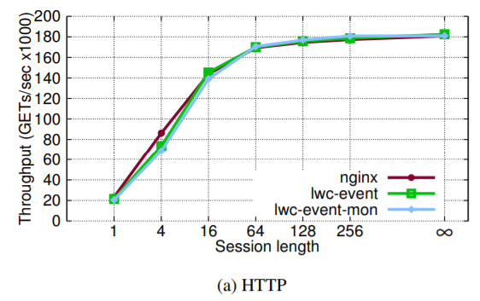
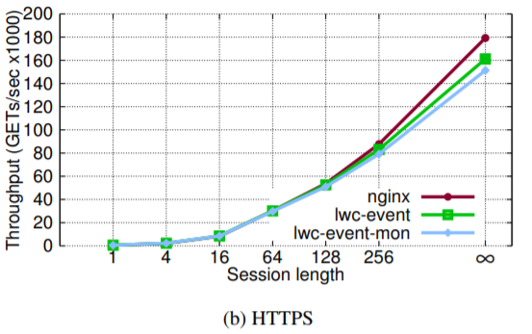
nginx execution
Figure shows the average number of queries served by each of the configurations over five runs of 60 seconds each. The standard deviation did not exceed 0.9%.
Figure 4: Nginx throughput in GETs/sec with 10 workers, 45B documents, 300 concurrent requests.
Error bars show standard deviation, which was below 0.9%.

Slide 30
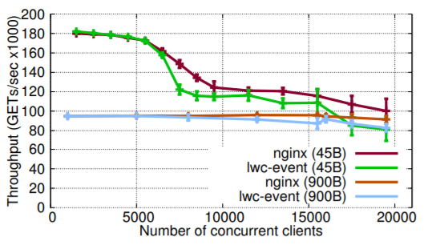
nginx execution
Figure shows the average number of requests served, over 5 runs of the experiment, as a function of the number of client sessions for stock nginx and lwc-event for both file sizes.
Nginx cumulative throughput in GETs/sec with 10 workers, session length 256, 45B and 900B documents, increasing number of concurrent clients. Error bars show standard deviation.

Slide 31
nginx execution
Overall, our results show that using lwCs, it is possible to implement features such as session isolation and reference monitoring at low cost for both HTTPS and HTTP sessions, and even in a high-performance server under a challenging workload.

Slide 32
Isolating OpenSSL keys
lwCs provide a particularly effective way to isolate sensitive data from network-based attacks such as buffer overflows or overreads.
The sensitive data is stored in a lwC, within the process, such that the network-facing code has no visibility into pages that store the sensitive data.
In this way, unless the kernel is compromised, the data is guaranteed safe, but access to functions that require the data can be rapid, using a safe lwC-crossing interface.

Slide 33
FCGI fast launch
We demonstrate the utility of lwC snapshotting by adding a “fast launch” capability to a PHP application.
When a PHP request is served, a PHP script is read from disk, compiled by the interpreter, and then executed.
During execution, other PHP files may be included and executed.
We modified the PHP 7.0.11 programming language to add a pagecache call that allows the script to “fastforward” using previous snapshots.
Our implementation augments PHP-FPM, which functions as a FCGI server for nginx.

Slide 34
FCGI fast launch
This result is remarkable in that it shows lwCs can provide significant performance benefit to highly optimized end-to-end applications such as web frameworks, while adding isolation between user requests.

Slide 35
Conclusion:
They have introduced and evaluated light-weight contexts (lwCs), a new first-class OS abstraction that provides units of isolation, privilege, and execution state independent of processes and threads.
Results shows that fast roll-back of FCGI runtimes, compartmentalization of crypto secrets, isolation and monitoring of user sessions can be implemented in the production Apache and nginx web server platforms with performance close to or better than the original configurations in most cases.

